Slide 2
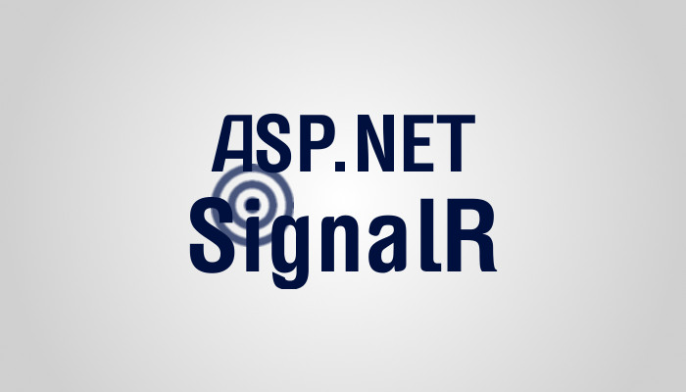
Intro to SignalR
Anne Bougie
@bougiefever

Slide 3
What Are We Going To Cover?
What is SignalR?
When to use SignalR?
Technology behind SignalR
Transport Protocols
Hubs vs Persistent Connection
Hub Pipelines
Hosting SignalR
IIS
Self Hosting using Katana
Javascript Client
.NET Client

Slide 4
What Is SignalR?
Library in .NET for providing real-time web.
The ability for the server to push functionality to the client.
Candidates for real-time are social media, dashboards, collaborative apps, progress updates, or any place real-time updates are needed

Slide 5

What Is SignalR
The Old Way
The SignalR Way
Got anything?
Hi – Do you want to party?
Got anything?
Sure do – Select your transport
Web Client
Web Server
Web Client
Web Server
Got anything?
WebSockets. I’m ready to party!
Got anything?
Let’s get this party started!
Got anything?
Get down, boogie oogie oogie…
Yep. Here ya go…
Got anything?

Slide 6
When to use SignalR
Use It
When data changes frequently
When the server needs to push data to the client and…
The client also initiates requests (chat)
When you need real-time updates when events occur (games)
Lose it
When data doesn’t change very fast
When only the client initiates the requests (get gps coordinates)
When only the server initiates notifications (stock ticker)
When you don’t need real-time updates (calendar scheduling)

Slide 7
SignalR Technologies
ASP.NET Server Application
Hubs
Persistent Connection
Transport Protocols
HTML5
HTTP
Web Sockets
Server-sent Events
Forever Frame
Long Polling
Web Browser Application
.NET Client
Mobile Device
Transport
Transport
Transport

Slide 8
First Example Persistent Connections
Notes:
Open FirstSampleChat
Has Microsoft.AspNet.SignalR nuget package installed
Add PersistentConnection - signalr_first_pc - signalr_first_pc_complete
signalr_first_pc_html
signalr_first_pc_script
Add Startup class - app.MapSignalR<FirstPersistentConnection>("/FirstSamplePC");
signalr_first_pc_startup

Slide 9
SignalR Nuget Packages
Microsoft.AspNet.SignalR
Microsoft.AspNet.SignalR
Microsoft.AspNet.SignalR.JS
Microsoft.AspNet.SignalR.Core
Microsoft.AspNet.SignalR.SystemWeb
Microsoft.Owin
Microsoft.Owin.Security

Slide 10
PM> Install-Package Microsoft.AspNet.SignalR
Attempting to gather dependencies information for package 'Microsoft.AspNet.SignalR.2.2.0' with respect to project 'FirstSampleChat', targeting '.NETFramework,Version=v4.5.2'
Attempting to resolve dependencies for package 'Microsoft.AspNet.SignalR.2.2.0' with DependencyBehavior 'Lowest'
Resolving actions to install package 'Microsoft.AspNet.SignalR.2.2.0'
Resolved actions to install package 'Microsoft.AspNet.SignalR.2.2.0'
Adding package 'Microsoft.AspNet.SignalR.JS.2.2.0' to folder 'c:\_presentation\FirstSampleChat\packages'
Added package 'Microsoft.AspNet.SignalR.JS.2.2.0' to folder 'c:\_presentation\FirstSampleChat\packages'
Added package 'Microsoft.AspNet.SignalR.JS.2.2.0' to 'packages.config'
Successfully installed 'Microsoft.AspNet.SignalR.JS 2.2.0' to FirstSampleChat
Adding package 'Microsoft.AspNet.SignalR.Core.2.2.0' to folder 'c:\_presentation\FirstSampleChat\packages'
Added package 'Microsoft.AspNet.SignalR.Core.2.2.0' to folder 'c:\_presentation\FirstSampleChat\packages'
Added package 'Microsoft.AspNet.SignalR.Core.2.2.0' to 'packages.config'
Successfully installed 'Microsoft.AspNet.SignalR.Core 2.2.0' to FirstSampleChat
Adding package 'Microsoft.AspNet.SignalR.SystemWeb.2.2.0' to folder 'c:\_presentation\FirstSampleChat\packages'
Added package 'Microsoft.AspNet.SignalR.SystemWeb.2.2.0' to folder 'c:\_presentation\FirstSampleChat\packages'
Added package 'Microsoft.AspNet.SignalR.SystemWeb.2.2.0' to 'packages.config'
Successfully installed 'Microsoft.AspNet.SignalR.SystemWeb 2.2.0' to FirstSampleChat
Adding package 'Microsoft.AspNet.SignalR.2.2.0' to folder 'c:\_presentation\FirstSampleChat\packages'
Added package 'Microsoft.AspNet.SignalR.2.2.0' to folder 'c:\_presentation\FirstSampleChat\packages'
Added package 'Microsoft.AspNet.SignalR.2.2.0' to 'packages.config'
Successfully installed 'Microsoft.AspNet.SignalR 2.2.0' to FirstSampleChat

Slide 11
Hubs vs Persistent Connections
Hubs
Hubs is an abstraction over Persistent Connections
Routes are automatically mapped
Protocol is defined by SignalR
Hubs is usually a better choice for most applications
Persistent Connections
Low level, so you have more control
Routes must be defined in Startup
You must serialize and deserialize any data sent and received
If you are converting an existing application using a messaging and dispatching model, it might be easier to use

Slide 12
protected override Task OnReceived(IRequest request, string connectionId, string data)
{
var message = JsonConvert.DeserializeObject<Message>(data);
switch (message.Type)
{
case "sendToMe":
Connection.Send(connectionId, message.Content);
break;
case "sendToConnectionId":
Connection.Send(message.ConnectionId, message.Content);
break;
case "sendBroadcast":
Connection.Broadcast(message.Content);
break;
case "sendToGroup":
Groups.Send(message.GroupName, message.Content);
break;
case "joinGroup":
Groups.Add(message.ConnectionId, message.GroupName);
Connection.Broadcast(message.ConnectionId + " joined group " + message.GroupName);
break;
case "leaveGroup":
Groups.Remove(message.ConnectionId, message.GroupName);
Connection.Broadcast(message.ConnectionId + " left group " + message.GroupName);
break;
case "throw":
throw new InvalidOperationException("Client does not receive this error");
}
return base.OnReceived(request, connectionId, data);
}

Slide 13
First Example Hubs
Notes:
Add ChatHub class to Hubs folder.
Add method for chatting
signalr_first_hub_broadcast
signalr_hub_script
signalr_hub_html
Add custom client name
[HubName("chat")]
Add complex type
signalr_hub_complex_type
Update method
signalr_hub_add_type
Update html
signalr_hub_add_name_html
signalr_hub_script_add_name

Slide 14
SignalR Transport Protocols
WebSockets
Full duplex
Server-sent Events
Creates pipeline from server to client
Client to server uses AJAX calls
Forever Frame
Hidden IFrame with a connection to the server
Client to server uses AJAX calls
Long Polling
Opens an AJAX call for the server to call the client. Reopens when it times out
Client to server uses AJAX calls

Slide 15
SignalR Transport Selection

Slide 16
Calling Specific Clients
Notes:
signalr_first_hub_spec_clients

Slide 17
Calling Groups
Notes:
Hub
signalr_rc_hub_first
Refs on view
signalr_rc_refs
Html on view
sr_rooms_html
Script on view
sr_rooms_script

Slide 18
SignalR Clients
Javascript
.NET
Windows Phone
iOS
Android
Others - Node

Slide 19
.NET Client
Notes:
Add auction folder to hubs
Add auction script
sr_auction_script
Html:
sr_auction_html
Go over auction hub & javasctript client
Go over .net client

Slide 20
Extending With HubPipelines
Notes:
GlobalHost.HubPipeline.AddModule(new LoggingPipelineModule());
sr_logging_pipeline

Slide 21
Security
Notes:
Hub changes
sr_auth_hub
Script
sr_rooms_auth_script
Html
sr_rooms_auth_button
Update security on project
-- show auth on persistent client

Slide 22
SignalR Troubleshooting & Diagnostic Tools
Browser Developer Tools
Set logging to true on client
Enable Detailed Errors on server – sends full exception stack details to client
Fiddler
Microsoft.AspNet.SignalR.Utils Nuget Package
Performance Counters – signalr.exe ipc
Hub Proxy Generation – signalr.exe ghp
System Diagnostics

Slide 23
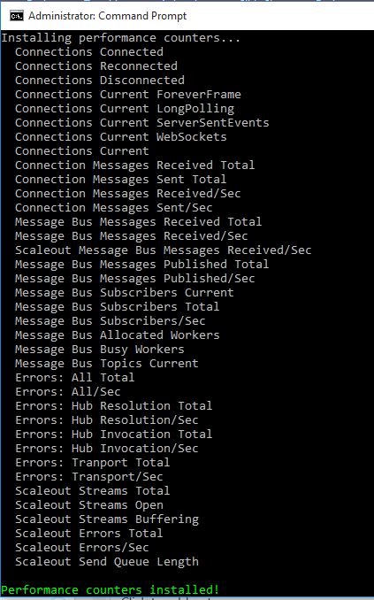
Performance Counters Added

Slide 24
TroubleShooting
Notes:
Show logging on client and server
$.connection.hub.logging = true;
Add detailed logging on server
var hubConfiguration = new HubConfiguration();
hubConfiguration.EnableDetailedErrors = true;
app.MapSignalR(hubConfiguration);
signalr_diagnostics

Slide 25
SignalR Supported Server Platforms
Windows Server 2012
Windows Server 2008 R2
Windows 8
Windows 7
Azure
Linux

Slide 26
SignalR Supported Server Platforms
Windows Server 2012
Windows Server 2008 R2
Windows 8
Windows 7
Azure
Linux

Slide 27
SignalR Hosting
IIS8+ WebSockets
IIS7
IIS must run in integrated mode, and the application must run in full-trust mode
Self host in a Windows service
Self host with Katana
Azure running 4.5 framework and WebSockets must be enabled
Linux using Mono

Slide 28
Hosting in IIS

Slide 29
Hosting in IIS
Recommended Settings for IIS Hosting
Decrease Message Buffer Size to 500
Default is 1000
Increase Maximum Number of Concurrent Requests to 10000
Default size is 5000
Increate Request Queue Limit to 250000
Notes:
Buffer – default 1000 msgs per hub per connection – might cause memory issues if msgs are large – decrease the # of msgs in memory

Slide 30
Cross-Domain Issues
Enabling CORS
Add Nuget package Microsoft.Owin.Cors
Enable CORS in the Owin Startup of the host project
app.UseCors(CorsOptions.AllowAll);

Slide 31
Self-Hosting

Slide 32
Scaling with Sql Server Backplane
Notes:
Add Microsoft.AspNet.SignalR.SqlServer

Slide 33
SignalR Sql Backplane
Create or Select Database
Use Dependency Resolver to add UseSqlServer directive
Database needs Set Enable Broker enabled
Notes:
ALTER DATABASE SignalRSample SET ENABLE_BROKER
Data Source=LT0127;Initial Catalog=SignalRSample;Integrated Security=true;

Slide 34
Resources
http://www.asp.net/signalr
http://kevgriffin.com/signalr-transports-explained/
http://blog.3d-logic.com/2015/03/29/signalr-on-the-wire-an-informal-description-of-the-signalr-protocol/
Books:
Apress Pro ASP.NET SignalR
Packt Pub SignalR: Real-Time Application Development
Packt Pub SignalR Real-Time Application Cookbook
Anne Bougie @bougiefever
abougie@skylinetechnologies.com

